Slide 1
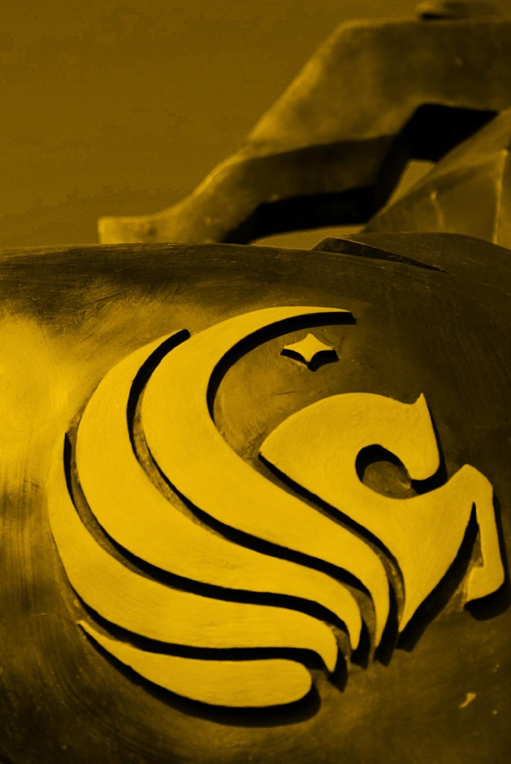
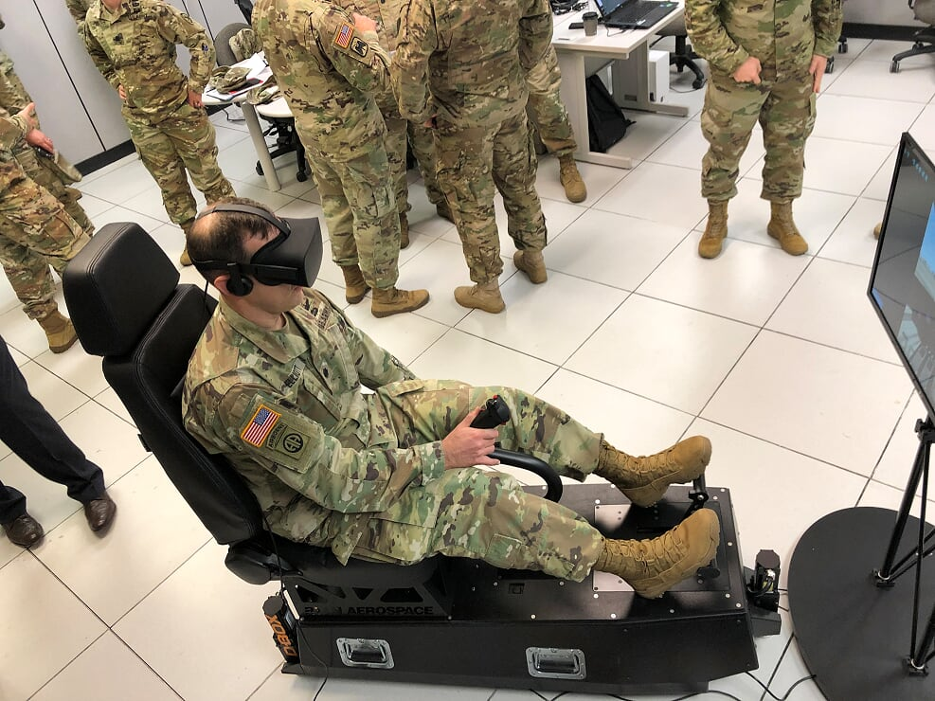
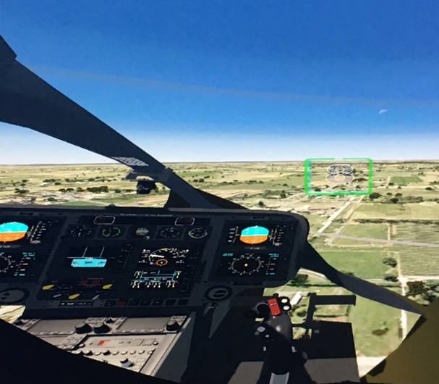

Cockpit Commander Ethan Levin Erica Faulkner Chris McFarland

Slide 2

Agenda
Background
Purpose
User Need
Proposed Solution
Way Ahead
Questions/Feedback

Slide 3
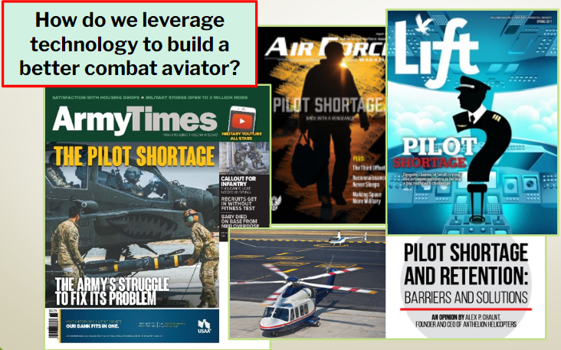
Background
Current training approach remains technologically deficient
Lack of ability to adjust training

Slide 4
Research Problem

Slide 5
RQ/Hypothesis

Slide 6

Related Work (Lit Review)
Gandhi, R. D., & Patel, D. S. (2018).
Virtual Reality – Opportunities and Challenges.
Virtual reality adds an extra “layer” of immersion which allows users to have the feeling that they are truly being placed in a new environment
Makransky, G., Terkildsen, T. S., & Mayer, R. E. (2019).
Adding immersive virtual reality to a science lab simulation causes more presence but less learning.
While participants reported being more immersed in the VR environment, it was found that cognitive workload increased while performance on the task decreased when using VR.
Parong, J., & Mayer, R. E. (2018).
Learning science in immersive virtual reality.
Participants who were shown a slideshow scored higher on posttest than VR group, however those participants also reported lower motivation, engagement, and interest in the experiment.

Slide 7
Methods (DOE)
Design of Experiment
Groups:
PPT Only
50 Pre Flight School Students (2 For this Class)
VR Device Only
50 Pre Flight School Students (2 For this Class)
Data Collection:
- Pre-made checklist scored by same IP for all (Provided by DOS) - All groups conduct same flights and conduct post flight survey to culminate session.
Conduct Post Test in VR and complete prescribed surveys
Conduct Post Test in VR and complete prescribed surveys

Slide 8
Inclusion and Exclusion Criteria
Inclusion Criteria:
Must be a United States Citizen.
Each participant must be 18 - 50 years old.
Each participant must have normal or corrected-to-normal vision.
No previous history of seizures.
Be in good health at time of testing.
Exclusion Criteria:
Not meet the inclusion criteria.

Slide 9
Study Timeline PPT
Complete informed consent, demographic survey, and Baseline Simulator Sickness Questionnaire (SSQ): 15 minutes
Conduct Training in PPT: 15 minutes
Conduct Prepared 3D (P3D) simulated flight exam in VR: 10 minutes
Graded by Instructor Pilot
Complete post flight survey and SSQ #2: 5 minutes
Debrief: 5 minutes

Slide 10
Study Timeline VR Device
Complete informed consent, demographic survey, and Baseline Simulator Sickness Questionnaire (SSQ): 15 minutes
Conduct Training in Prepared 3D (P3D) simulated flight in VR: 15 minutes
Complete SSQ #2: 5 minutes
Conduct Prepared 3D (P3D) simulated flight exam in VR: 10 minutes
Graded by Instructor Pilot
Complete post flight survey and SSQ #3: 15 minutes
Debrief: 5 minutes

Slide 11
Equipment used
PPT
Vive Pro
Helimod
Surveys
Demo
SSQ
Grade sheet

Slide 12
Pics of Device and scenarios

Slide 13
Surveys and Grade Sheet

Slide 14
Early Results

Slide 15
Challenges:
Scenario development timeline
Data collection and storage
Training accreditation of the device
Ability for all Instructor Pilots to adjust to new training approach
Culture

Slide 16

Questions?

Slide 17
Reference

